Slide 1

Machine Programming
Identify Instruction Set Architecture
Know a
brief history
of x86 processors
Understand
the lifetime of
a program
Name
x86 integer registers
① Instruction Set Architectures
② Machine Programming
Notes:
Minh-Quoc NGHIEM
Last update: 27/12/2016

Slide 2


Machine vs. human language
Add 5 and 8
011000110101
instructions
words
instruction set
vocabulary
machine language
assembly language
03 45 08
add 0x8(%ebp),%eax

Slide 3

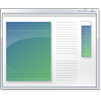
Lifetime of Program
Code time
Compile time
Run time
C/C++
ASM
Object
Compiler
Assembler
Linker

Slide 4
Code Examples
Compiler
Assembler
C/C++
ASM
Object
Disassembler
gcc –Og –c example.c
objdump –d example.o
gcc –Og –S example.c
Notes:
gcc –Og –S example.c

Slide 5
Program Performance
Program
Compiler
Hardware
Architecture
CHAP

Slide 6
① System’s state
③
② Instructions
CPU can execute
Instruction
Set
Architecture
Architecture
Notes:
Instructions: có gì, làm gì, encode ntn
Registers: có bao nhiêu, wide?
Memory: xác định vị trí trong bộ nhớ

Slide 7


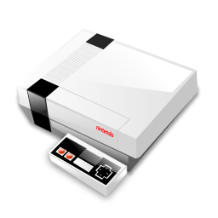






Instruction Set Architectures
x86
MIPS
PowerPC

Slide 8
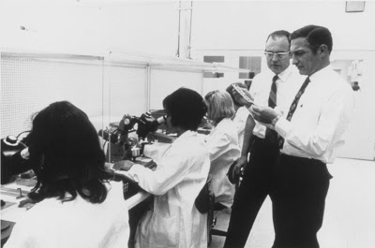
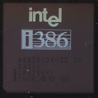
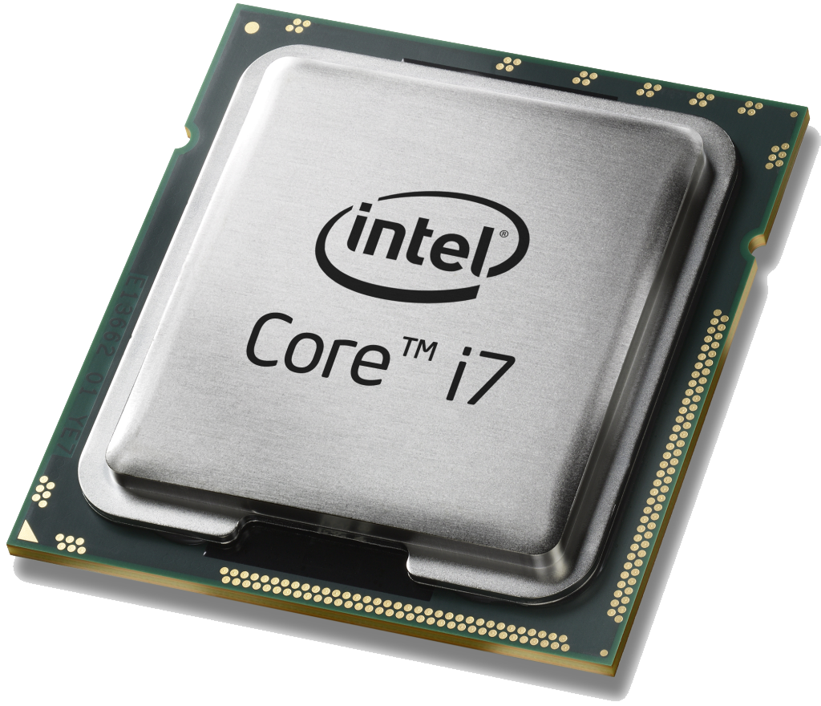
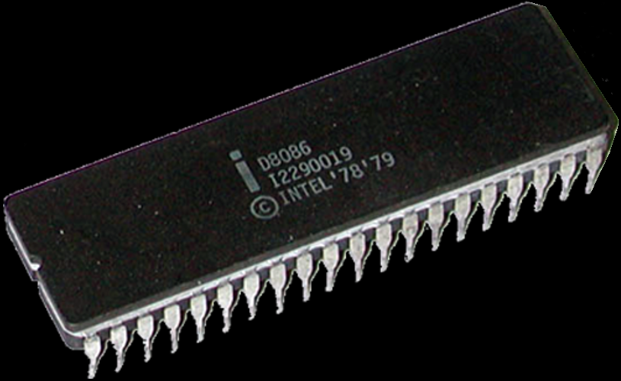
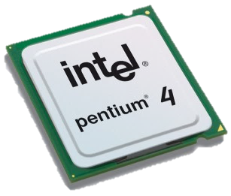
Intel
1968
1985
2016
1978
2005
Transistor
count
29K
275K
250M
7.2B
Notes:
# Transistors

Slide 9


Gordon Moore
Co-founder of Intel
The number of transistors in a chip will approximately double every two years.
Notes:
Someinterestingfactsaboutwhatthesevarious-sizedbytescanstore:1bit:abinarydecision1byte:acharacter5Megabytes:ThecompleteworksofShakespeare2Gigabytes:20metersofshelvedbooks10Terabytes:TheprintedcollectionoftheUSLibraryofCongress200Petabytes:Allprintedmaterialinthewholeword.5Exabytes:Allwordseverspokenbyhumanbeings
Themostcommonlyacceptedexplanationisthatourbase-10numbersystemwasadoptedbyourancestorsmostlikelybecausewehave10fingers.Interestinglyenough,maybethatiswhydigitinEnglishalsomeansafingerortoe.

Slide 10

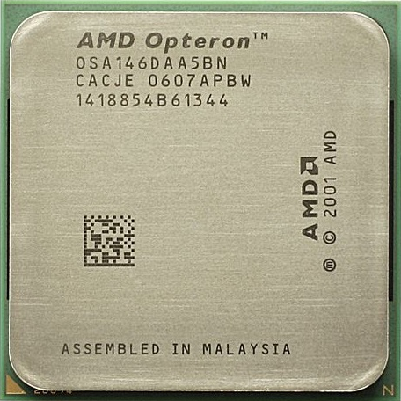
Advanced Micro Devices

Slide 11

Programmer’s View
Memory
Object
Code
Program
Data
OS Data
Address
Registers
Data
Condition Codes
Instructions
Program Counter
Stack
CPU

Slide 12
Compiling
32-bit
int sum(int x, int y)
{
int t = x+y;
return t;
}
sum:
push %ebp
mov %esp,%ebp
mov 12(%ebp),%eax
add 8(%ebp),%eax
mov %ebp,%esp
pop %ebp
ret
code.c
gcc –O1 –S code.c
sum:
leal (%rdi,%rsi),%eax
ret
64-bit
Notes:
code.c

Slide 13
Categories of Registers
Data
Address
Floating point
Instruction
Conditional
Constant (zero, one, or pi)
Vector
Special-purpose
General purpose registers (GPRS)

Slide 14
IA32 Integer Registers
%rax
accumulate
%eax
%r8
%ax
%rbx
base
%ebx
%r9
%bx
%rcx
counter
%ecx
%r10
%cx
%rdx
%r11
%edx
data
%dx
%rsi
source index
%esi
%r12
%si
%rdi
destination index
%edi
%r13
%di
%rsp
stack pointer
%esp
%r14
%sp
%rbp
base pointer
%ebp
%r15
%bp
x86-64 Integer Registers

Slide 15
Sub-register
rax
al
ax
eax
Same for rbx, rcx, rdx
Notes:
Same for rbx, rcx, rdx, rsi, rdi, rbp, rsp

Slide 16
Sub-register
rsi
sil
si
esi
Same for rdi, rbp, rsp
Notes:
Same for rbx, rcx, rdx, rsi, rdi, rbp, rsp

Slide 17
Sub-register
r8
r8b
r8w
r8d
Same for r9, r10, r11, r12, r13, r14, r15
Notes:
eax

Slide 18
Summary
Instruction Set Architecture
Program Performance
Intel x86 Architecture
x86 Registers

